Slide 1
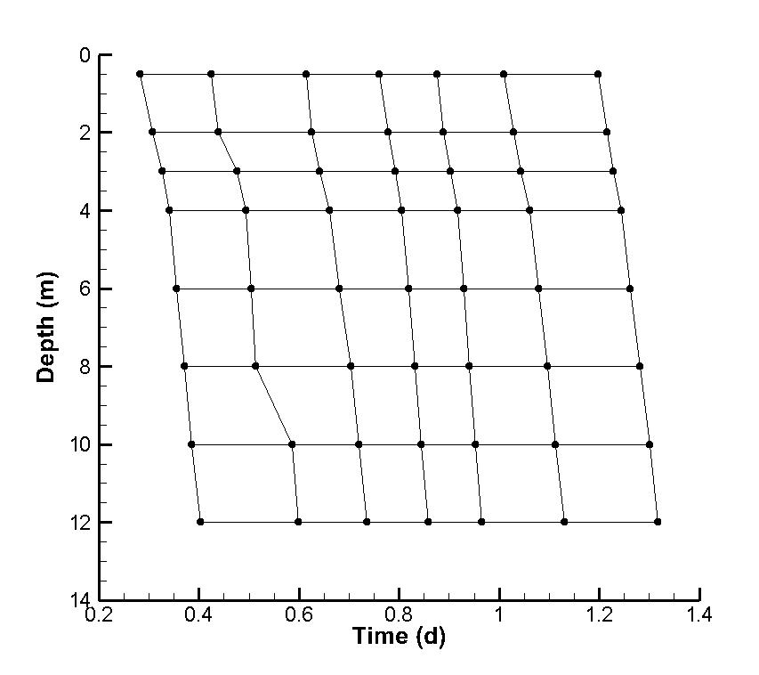
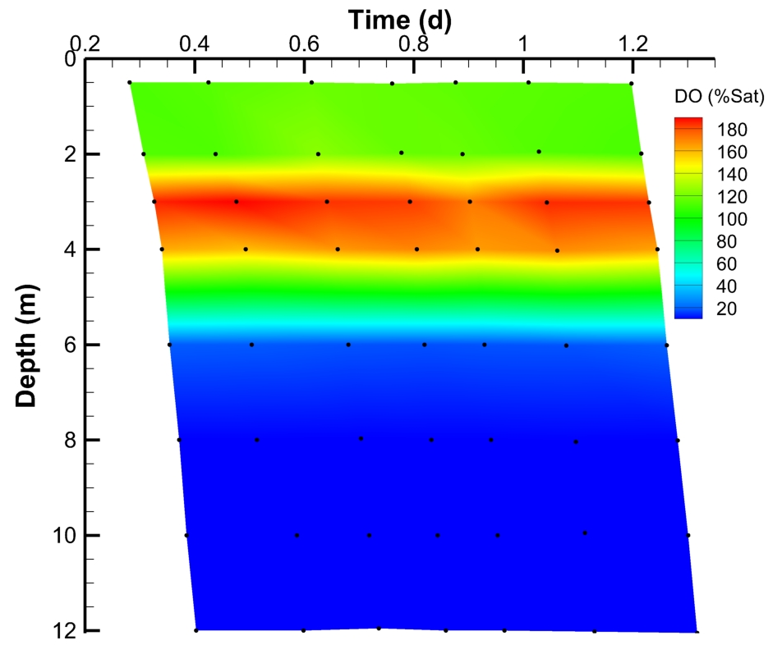
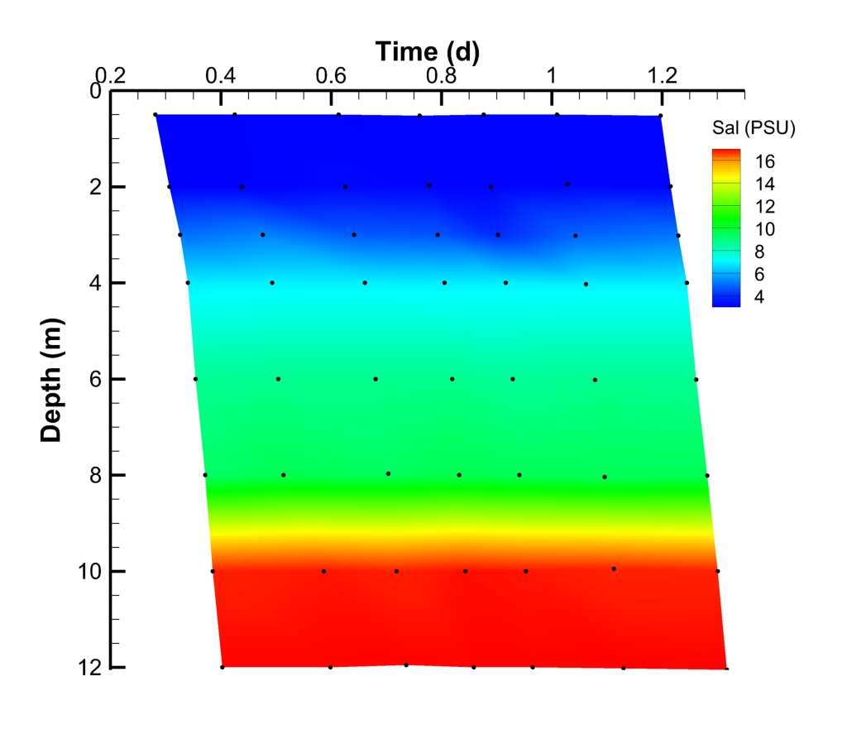
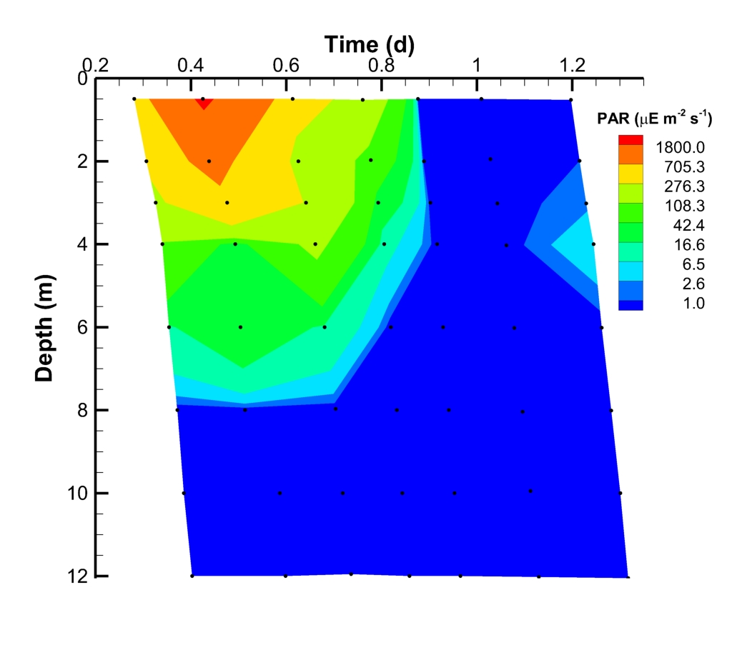
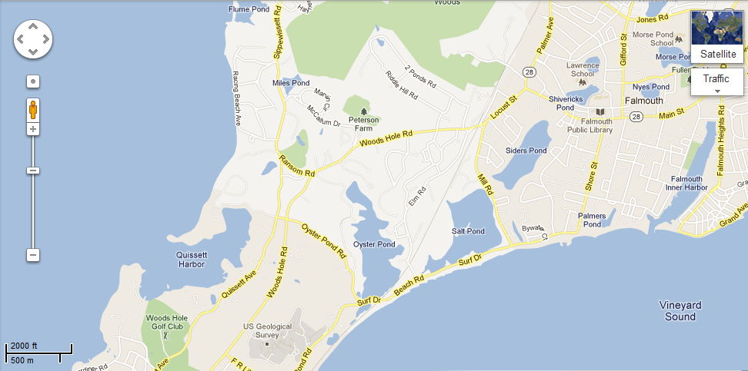
Assessing Microbial Organization Over Time and Space in Siders Pond
Petra K. Byl^{1, 2}, Leslie Murphy², Julie Huber ², Joseph Vallino² ¹University of Chicago, Chicago, IL; ²Marine Biological Laboratory, Woods Hole, MA
Importance of Microbial Metabolic Networks
Life is limited by the availability of C, H, O, N, P, S, and trace metals; most organisms can only utilize discrete forms of these elements.
Communities of bacteria and archea consume and cycle life-limiting elements through the biosphere via metabolic redox reactions.
Over time and space, microbial metabolic pathways contribute to complex metabolic networks, which mediate biogeochemical cycles and the habitability of an ecosystem.
The ability to predict how microbial metabolic networks organize and function will facilitate our understanding of how microbial metabolic networks adapt to anthropogenic pressures and alter biogeochemical cycles.
The goal of our study is to understand how microbial metabolic networks are organized over time and space.
Methods
Results: Dissolved Oxygen Maximum
6:45am
10:12am
6:15pm
12:14am
Physical Profiling
Salinity
Conductivity
Temperature
Photosynthetically Active Radiation - PAR
Dissolved Oxygen
pH
3. Chemical Profiling
NO₂
NO₃
NH₄
PO₄
Dissolved Fe & Mn
Particulate Fe & Mn
H₂S
SO₄/Cl
Dissolved inorganic carbon
Dissolved organic carbon
Particulate organic carbon
Chlorophyll A
2:44pm
9:02pm
4:44am
2. Biological Profiling
Cell counts (DAPI) DNA quantification (picogreen)
Metagenome
Metatranscriptome
Graph 7. Dissolved oxygen increases before dawn, however PAR does not change- suggesting a circadian rhythm.
Figure 2. Our sampling grid is shown above. Each black dot represents a sample taken at a specific time and depth.
Questions
How does physical forcing in the environment impact the structure and function of microbial communities?
Are microbial metabolic networks in nature organized over time and space? Can we detect a circadian rhythm?
Results: Physical & Chemical Profile
Proteobacteria
Cyanobacteria
Proteobacteria
Cyanobacteria
These physical forcings apply environmental pressure to the structure of microbial community.
Planctomycetes
Unclassified Bacteria
Planctomycetes
Bacteroidetes
Planctomycetes
Unclassified Bacteria
Actinobacteria
Bacteroidetes
Actinobacteria
Field Site: Siders Pond, Falmouth, MA
Siders Pond is a permanently stratified meromictic kettle pond. The intrusion of sea-water during storm events establishes a density gradient.
We hypothesize that the density gradient gives rise to a host of diverse metabolic pathways.
A profile of the pond was constructed over a day-night cycle on June 25-26, 2015 at depths 0.5m, 2.0m, 3.0m, 4.0m, 6.0m, 8.0m, 10.0m, and 12m
Unclassified Eukaryota
Unclassified Eukaryota
Graphs 8 & 9. The microbial community at depth 3.0m and 4.0m are dominated by 20% and 23% cyanobacteria, a phylum of photosynthetic microorganisms.
hν
Autotrophs
CO₂
O₂
OM
Heterotrophs
Figure 1. Above an aerial view of Siders Pond is depicted along with a picture taken of Siders Pond on June 25, 2015.
Graphs 2 & 3. Graph 2 demonstrates that there is a continual gradient in salinity over depth, but graph 3 exhibits dynamic change over time since PAR is dependent upon the sunrise and sunset.
Graph 4. Dissolved oxygen peaks at 3-4m due to photosynthetic activity, and the top 2m are well mixed with atmospheric oxygen.
Results: Biological Profile
Proteobacteria
Graph 10. Genes that regulate the circadian rhythm (KaiABC) and sync the internal cycle to outside stimuli (LdpA C, CikA) were most abundant at depth 4.0mm
Actinobacteria
Summary
The top 6m of the water column are oxygenic and gradually become more saline. As a result, the microbial community is composed of aerobic heterotrophs and phototrophs. Phototrophs at 3.0m and 4.0m increase dissolved oxygen in the water column.
Genomic potential and geochemistry at 3.0m and 4.0m hint at a microbial circadian rhythm.
The environment at 8.0m becomes anoxic and the microbial community shifts to anerobic phototrophs.
Sunlight does not penetrate below 8.0m, so depths 10.0-12.0m have a distinct microbial community.
.
Cyanobacteria
Planctomycetes
Bacteroidetes
Chlorobi
Euryarchaeota
Graph 1. In Siders Pond salinity increases over depth, whereas dissolved oxygen and temperature decrease. These three physical forcings remained stable over time. The profile was constructed from data collected at our first sampling time point.
Graph 5. Cell counts peak at the dissolved oxygen maximum of 3m, and again at the bottom of Siders pond possibly due to detritus. Error bars signify a standard deviation.
Graph 6. Taxonomy changes drastically over 12m of depth due to the chemical and physical signature of the water column. We blasted our metagenome against a 16S rRNA database, mothur, to configure a taxonomic profile.
Future Investigation
We will analyze the expression of functional genes over time and space using the metatranscriptome data as well as modeling the microbial metabolic network.
Acknowledgements to the Jeff Metcalf Internship and NSF

